Slide 1


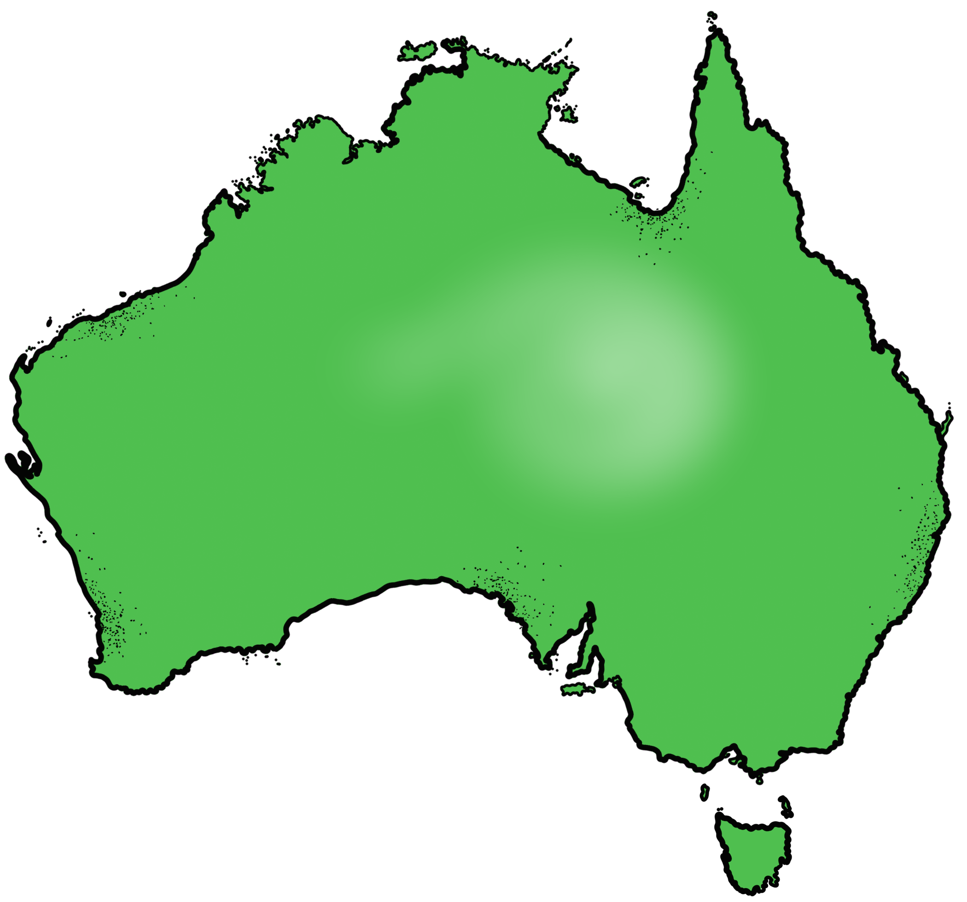
Australian curriculum – Civics and citizenship

Slide 2
Common Law
Learning objective: Identify and describe how common laws are made through court.

Slide 3
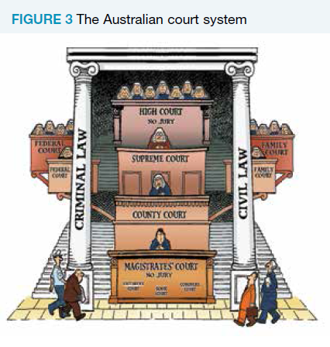
Court hierarchy
The High court is the Highest of all the courts which is then followed by the Supreme Court, Country or district court and Magistrates court.
Each court has different branches such as the Family court and Federal court.
Learning objective: Identify and describe how common laws are made through court.

Slide 4
Why are laws needed?
Laws provide the framework in which society functions so individuals can cooperate and live in harmony. This is known as social cohesion. Without laws there would be no guidelines on what is acceptable behaviour. The main aim of laws is to protect individuals from harm and to ensure that the rights of individuals are preserved. Without laws, people would not feel safe to walk down the street. The existence of these laws deters most people from committing crimes.
Cooperate – work jointly towards the same end.
Cohesion – the action or fact of forming a united whole.
Preserved - maintain (something) in its original or existing state.
Deters - discourage (someone) from doing something by instilling doubt or fear of the consequences.
CFU:
Why do we need laws?
What is the main aim of laws?
Learning objective: Identify and describe how common laws are made through court.

Slide 5
When people live together, laws will be broken and disputes will arise as each person competes for a share of the same space and resources. To survive, society must develop a mechanism of dispute resolution so disputes that arise can be settled peacefully. Laws need to reflect the values and attitudes of the majority in the community, and need to change as values and attitudes change.
Disputes – a disagreement or argument.
Competes – be able to rival another or others.
Majority – the greater number/ most of.
CFU:
To survive what must society do?
What do laws need to reflect?
Learning objective: Identify and describe how common laws are made through court.

Slide 6
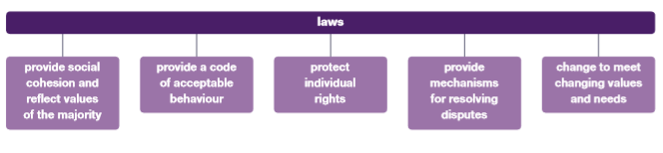
CFU:
Laws provide a code……..
Why do laws change?
Learning objective: Identify and describe how common laws are made through court.

Slide 7
What is Common law?
READ/TRACK/PRONOUNCE
Common law was founded in England and adopted by the Australian legal system. It is law developed through the courts and is also known as judge-made law. It can only be created when a case is brought to the courts. It is therefore also known as case law. It develops through the doctrine of precedent.
CFU:
What is common law?
Where did common law come from?
Doctrine – a particular principle, position, or policy taught or advocated.
Precedent - preceding in time, order, or importance.
Learning objective: Identify and describe how common laws are made through court.

Slide 8
Regulatory control can be divided into two facets. The first we call legislation. Legislation is the laws or acts of the parliaments which lay down the rules governing society. The second, we call executive government or administration. This is the arm of government which implements the rules. Both, of course, are to be contrasted with the third arm of government which is the courts or the judiciary.
CFU:
1.What are two regulatory facets?
2. Pair share what arm of government implements the rules?
3. What are the three arms of government?
4. What is Legislation?
Vocabulary:
Facets – a particular aspect or feature of something.
Regulatory – serving or intended to regulate something.
Learning objective: Identify and describe how common laws are made through court.
READ/TRACK/PRONOUNCE

Slide 9
At the same time as the monarch and parliament were legislating with respect to prescriptive aspects of regulating society, the courts, in the name of the Crown, were resolving disputes between citizens. The monarch was less concerned with the matters which troubled ordinary subjects than with raising armies and collecting taxes to provide for them. Staying on the throne was a difficult job.
CFU:
What is the courts job? (pair share)
What are the three arms of government?
What is a dispute?
Vocabulary:
Monarch -
a sovereign head of state, especially a king, queen, or emperor.
Disputes - a disagreement or argument.
Learning objective: Identify and describe how common laws are made through court.
READ/TRACK/PRONOUNCE

Slide 10
Accordingly, the courts began to develop their own rules to assist in the resolving of common disputes. Faced with disputes about broken promises they began to develop the law of contract. Faced with disputes about injury and damage to persons and property they began to develop the law of torts or injury. The rules established by courts formed the backbone of the common law. They were not established like acts of parliament establish rules. They were not created as rules. They simply emerged from a pattern of decision-making by the courts.
CFU:
Why was Common law established?
What law was created for disputes about injury and damage?
The law of contract was developed for what type of disputes?
Disputes - a disagreement or argument.
Learning objective: Identify and describe how common laws are made through court.
READ/TRACK/PRONOUNCE

Slide 11
So, a doctrine of precedent (policy of importance) emerged in the law of contract. Contracts cannot be voluntary. Both parties must contribute something in money or money's worth. No judge has ever sat down and promulgated such a rule. It simply emerges from reading a series of cases. Once it had emerged, subsequent decisions noted the rule and recorded it. We know this process as the doctrine of precedent. The resulting body of cases is the common law.
Vocabulary:
Doctrine – a particular principle, position, or policy taught or advocated.
Precedent - preceding in time, order, or importance.
Promulgated – promote or make widely known.
Subsequent - coming after something in time; following.
CFU:
For a contract to work both parties have to?
What is a doctrine of precedent?
Learning objective: Identify and describe how common laws are made through court.
READ/TRACK/PRONOUNCE

Slide 12
What is common law?
a. Is the law made by judges when deciding a particular case before them.
b. A law that is common is all states.
c. A law that only rich people follow.

Slide 13
What is common law?
a. Is the law made by judges when deciding a particular case before them.
b. A law that is common is all states.
c. A law that only rich people follow.

Slide 14
Generally speaking, parliament has supremacy over the courts. Although it cannot reverse the results in particular court decisions, it can vary the common law through legislation.
Accordingly the parliament came, gradually, to modify the common law. For example, legislation was passed to require certain contracts to be in writing before they could be enforced. Over the course of time, parliaments have intruded more and more into the development of the common law. There are now hundreds of acts of parliament which modify it. In some fields the entirety of the common law has been displaced (taken over) by legislation.
Vocabulary:
Supremacy –the state or condition of being superior to all others in authority, power, or status
Legislation - the process of making or enacting laws.
Displaced - take over the place, position, or role of.
CFU: (pair share)
Who can change or modify common law and why?
What is common law?
Learning objective: Identify and describe how common laws are made through court.
READ/TRACK/PRONOUNCE

Slide 15
A good example is the criminal law. There once were common law crimes of murder, robbery and larceny (theft). However, for a very long time, these common law crimes and other crimes have mostly been replaced by crimes created or modified by legislation. The Commonwealth, Queensland and Western Australia have criminal codes. The whole of their criminal law is found in legislation.
Some acts of parliaments relate to topics which are wholly covered by statute and have never been the province of the common law, such as the raising of income tax. Other acts vary or amend the common law established over the years by the courts.
CFU: Pair/share
Why have statutory laws been established for criminal law?
What is common law?
Vocabulary:
Legislation - the process of making or enacting laws.
Larceny – Theft
Statute – a written law passed by a legislative body.
Amend - make minor changes to
Learning objective: Identify and describe how common laws are made through court.
READ/TRACK/PRONOUNCE

Slide 16
For the doctrine of precedent to operate it is necessary for inferior courts to follow precedents set in superior courts. Therefore precedent depends on the courts being organised in a hierarchy of courts.
The high court is the highest court in the country and is at the top of all the state and federal court hierarchies. A decision made by the High court on appeal from a state or territory court is binding on courts in all states and territories.
Vocabulary:
Legislature – create laws
Executive – implement laws
Judiciary – resolve disputes, make common law.
Precedent –a court decision that must be followed by another court lower in the hierarchy.
Inferior - lower in rank, status, or quality.
Binding - involving an obligation that cannot be broken
CFU:
1.What court is at the top of all courts?
2.What is common law?
3.Why must inferior courts follow precedents set in superior courts?
Learning objective: Identify and describe how common laws are made through court.
READ/TRACK/PRONOUNCE

Slide 17
Judges’ ability to make law
Judges are not free to make law when they feel the need arises. Judge-made law can only occur when an appropriate case is brought to the superior courts. Parliament, on the other hand, is free to make or change the law at any time if it feels the need exists.
Arises – emerge; become apparent.
CFU:
1.Can judges make law whenever they want?
2.Who is free to make or change laws at any time?
Learning objective: Identify and describe how common laws are made through court.
READ/TRACK/PRONOUNCE

Slide 18
The restrictions on judges in the way they make law are:
A case needs to be brought before the superior courts- judges can only develop or change the law when they have to decide a specific case. A case will be brought by a person who feels aggrieved or injured by a decision and has decided to have the issue resolved in court.
CFU:
Who can bring a case to court?
When can judges develop or change the law?
Aggrieved – feeling resentment at having been unfairly treated.
Learning objective: Identify and describe how common laws are made through court.
READ/TRACK/PRONOUNCE

Slide 19
Judges are bound by precedent – judges can make laws on a new issue that has not previously been considered by the courts or parliament (and so create a precedent). However, if a precedent has been created in a higher court in the same hierarchy and the facts are similar, then a lower court in the same hierarchy is bound to follow the reasoning or ratio decidendi in the earlier precedent.
Vocabulary:
Precedent –a court decision that must be followed by another court lower in the hierarchy.
Ratio decidendi - the rule of law on which a judicial decision is based.
Judicial - relating to the administration of justice
CFU:
What is a precedent?
When can judges make laws?
Learning objective: Identify and describe how common laws are made through court.
READ/TRACK/PRONOUNCE

Slide 20
Example of creation of common law
https://www.supremecourt.vic.gov.au/going-to-court/for-the-public/vce-education-program/video-resource-for-teachers-and-students
Cases involving Human rights involve the courts creating common laws. Discrimination against:
age
disability
race
sex, pregnancy or breastfeeding
marital or relationship status
sexual orientation, (gender identity or intersex status which fall under anti-discrimination legislation)
As these are disputes the court has to solve they have to come up with a common law which both parties agree with. This could be one party receiving compensation from the other.
CFU:
What cases involve the courts making common law?
Learning objective: Identify and describe how common laws are made through court.
READ/TRACK/PRONOUNCE

Slide 21
The legislature do what?
Solve disputes, make common law
Implement the law
Create laws

Slide 22
The legislature do what?
Solve disputes, make common law
Implement the law
Create laws

Slide 23
The Executive do what?
Solve disputes, make common law
Implement the law
Create laws

Slide 24
The Executive do what?
Solve disputes, make common law
Implement the law
Create laws

Slide 25
The judiciary do what?
Solve disputes, make common law
Implement the law
Create laws

Slide 26
The judiciary do what?
Solve disputes, make common law
Implement the law
Create laws

